Slide 1

Happy Stocks™
The worst investment advice you’ve ever had

Slide 2



The Why

Slide 3
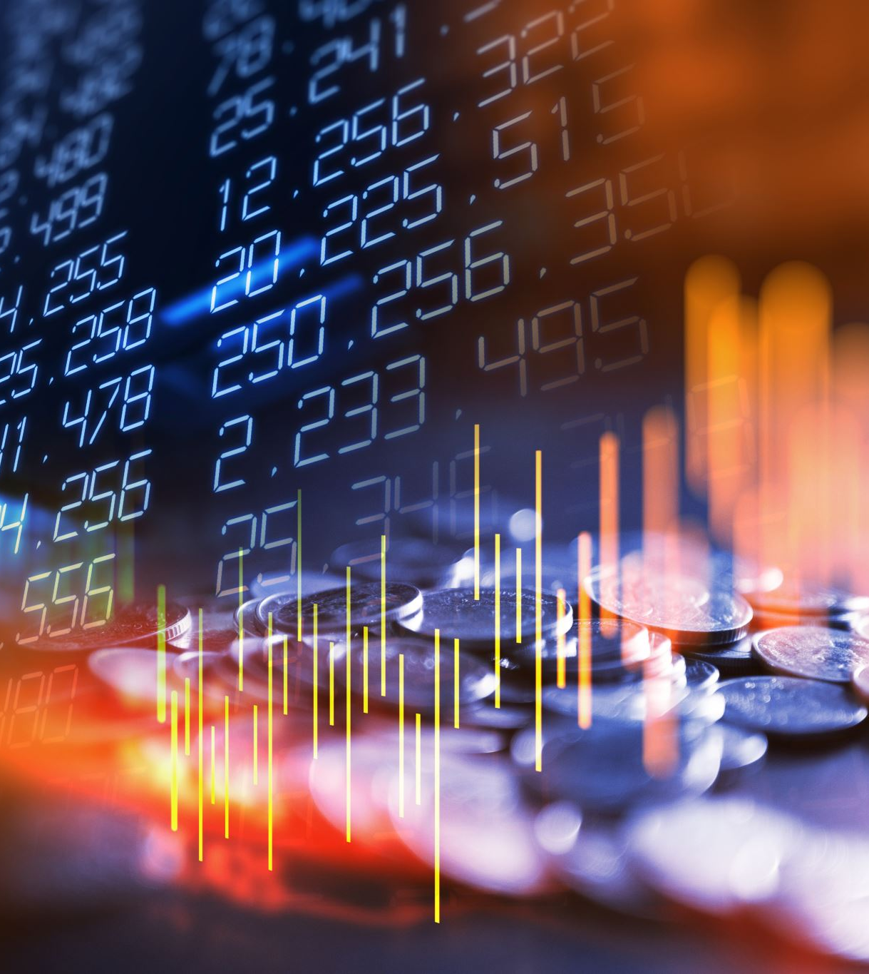
The What
Too many people buy stocks based off of making money
The plan was to use the World Happiness Report to allow people to buy stocks off of how happy it’ll make them, not off of if it’ll make them money

Slide 4

How stocks get converted into countries
Founding Year
Current Year
Profit Margin
Country’s Health
Country
Country
Dividend Yield
Country’s Freedom
Sentiment Analysis
Country’s Happiness
Market Capitalization
Country’s Corruption
Stock Price
Country’s Economy
How much you should buy
Country’s Generosity

Slide 5





How The ML Models Were Trained and Deployed
Training
Voting

Slide 6







How the front end works
Development
Deployment
Interaction
Use
Models
Make
Models
Ask for
data

Slide 7


